Slide 1

2. DESIGNING SUBSTANTIVE PROCEDURE
Notes:
Jika tidak terdapat resiko salah saji yang material maka substantive analytical procedur dapat dianggap cukup untuk menurunkan resiko dari salah saji ke level rendah yang dapat diterima

Slide 2
2.1 OVERVIEW OF DESIGNING SUBSTANTIVE PROCEDURE
Notes:
Jika tidak terdapat resiko salah saji yang material maka substantive analytical procedur dapat dianggap cukup untuk menurunkan resiko dari salah saji ke level rendah yang dapat diterima

Slide 3

Designing Substantive Procedures
In some situations where there is no significant risk of material misstatement, performing only substantive analytical procedures may be sufficient to reduce the risks of material misstatement to an acceptably low level.
The auditor may determine that only tests of details are appropriate, or that a combination of substantive analytical procedures and tests of details are most responsive to assessed risks.
Notes:
Analytical procedures tetap harus dilakukan untuk mengidentifikasi significant kenaikan atau penurunan yang dapat mengindikasikan adanya hal-hal yang perlu diperhatikan selama audit.

Slide 4
Summary of audit process
Phase I
Plan and design
an audit approach.
Phase III
Perform analytical
procedures and
tests of details
of balances.
Phase II
Perform tests of
controls and
substantive tests
of transactions.
Phase IV
Complete the
audit and issue
an audit report.
Notes:
Substantive testing dapat dianggap sebagai fase ke 3 dari audit proses.

Slide 5
Summary of the Audit Process (Cont’d) - Phase I
Accept client and perform initial planning.
Understand the client’s business and industry.
Assess client’s business risk.
Perform preliminary analytical procedures.
Set materiality and assess acceptable audit risk
and inherent risk.
Understand internal control and assess control risk.
Develop overall audit plan and audit program.

Slide 6
Summary of the Audit Process (Cont’d) - Phase II
Plan to reduce assessed
level of control risk?
No
Yes
Perform tests of controls.
Perform substantive tests of transactions.
Assess likelihood of misstatements in
financial statements.
Notes:
Sudah dibahas pada training sebelumnya.

Slide 7
Summary of the Audit Process (Cont’d) - Phase III
Low Medium High or
unknown
Perform analytical procedures.
Perform tests of key items.
Perform additional tests of details of balances.

Slide 8
Summary of the Audit Process (Cont’d) - Phase IV
Review for contingent liabilities.
Review for subsequent events.
Accumulate final evidence.
Evaluate results.
Issue audit report.
Communicate with audit
committee and management.

Slide 9
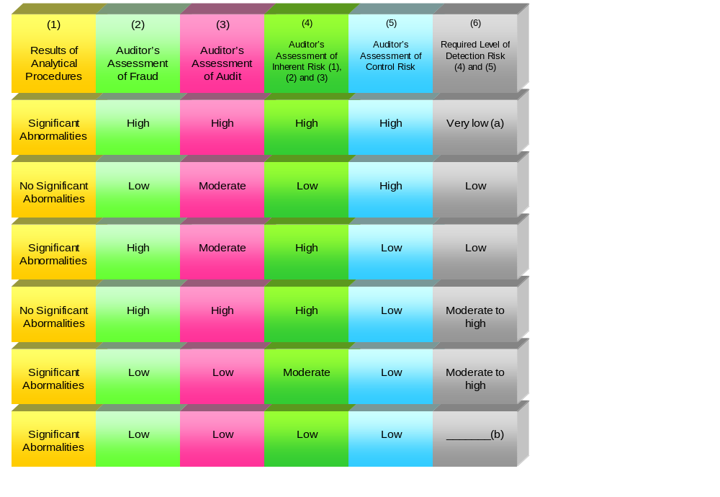
Determining the Required Level Detection Risk
For Planning and Substantive Audit Tests
Source: Auditing A Risk Analysis Approach; Larry F. Konrath
Notes:
Detection risk berbanding terbalik dengan substantive assurance

Slide 10
2.2 Responding to the risk of fraud

Slide 11
Responding to the risk of fraud (Cont’d)
Misstatements in the financial statements can arise from fraud or error. The distinguishing factor between fraud and error is whether the underlying action that results in the misstatement of the financial statements is intentional or unintentional.
ISA 240
Notes:
Branch visit sebaiknya berdasarkan surprise audit
Inventory count sebaiknya dilakukan mendekati tanggal laporan keuangan

Slide 12
Responding to the risk of fraud (Cont’d)
The term “fraud” refers to an intentional act by one or more individuals among management, those charged with governance, employees, or third parties, involving the use of deception to obtain an unjust or illegal advantage.
Although fraud is a broad legal concept, the auditor is concerned with fraud that causes a material misstatement in the financial statements. Auditors do not make legal determinations of whether fraud has actually occurred.
Notes:
Branch visit sebaiknya berdasarkan surprise audit
Inventory count sebaiknya dilakukan mendekati tanggal laporan keuangan

Slide 13
Responding to the risk of fraud (Cont’d)
Two types of intentional misstatements are relevant to the auditor, that is, misstatements resulting from fraudulent financial reporting and misstatements resulting from misappropriation of assets.
Notes:
Branch visit sebaiknya berdasarkan surprise audit
Inventory count sebaiknya dilakukan mendekati tanggal laporan keuangan

Slide 14
Responding to the risk of fraud (Cont’d)
Auditors should assess the risk of material misstatement due to fraud throughout the audit engagement.
In determining the nature, timing, and extent of auditing procedures to be applied to a specific potential error for an account balance or disclosure, auditor should design procedures to obtain reasonable assurance of detecting misstatements that we believe, based on the preliminary judgment about materiality, could be material, when aggregated with other misstatements, to the financial statements taken as a whole. This includes designing procedures to detect material misstatements due to fraud.
Notes:
Branch visit sebaiknya berdasarkan surprise audit
Inventory count sebaiknya dilakukan mendekati tanggal laporan keuangan

Slide 15
Responding to the risk of fraud (Cont’d)
The following are examples of possible audit procedures to address the assessed risks of material misstatement due to fraud resulting from both fraudulent financial reporting and misappropriation of assets.
Notes:
Branch visit sebaiknya berdasarkan surprise audit
Inventory count sebaiknya dilakukan mendekati tanggal laporan keuangan

Slide 16
Responding to the risk of fraud (Cont’d)
Visiting locations or performing certain procedures on a surprise or unannounced basis
Requesting that inventories be counted at the end of the reporting period or on a date closer to period end to minimize the risk of manipulation of balances in the period between the date of completion of the count and the end of the reporting period
Notes:
Branch visit sebaiknya berdasarkan surprise audit
Inventory count sebaiknya dilakukan mendekati tanggal laporan keuangan

Slide 17
Responding to the risk of fraud (Cont’d)
Altering the audit approach in the current audit period. For example, contacting major customers and suppliers orally in addition to sending written confirmation, sending confirmation requests to a specific party within an organization, or seeking more or different information.
Performing substantive analytical procedures using disaggregated data. For example, comparing sales and cost of sales by location, line of business, or month to the expectations we have developed.

Slide 18
How Frauds Have Been Discovered
Notification by employee
58%
Internal controls
51%
Internal auditor
43%
Customer notification
41%
Accidental discovery
37%
Management investigation
35%

Slide 19
How Frauds Have Been Discovered (cont’d)
Anonymous reporting
35%
Hot line notification
25%
Employee investigation
21%
Government notification
16%
External auditor
4%
Other sources
20%

Slide 20
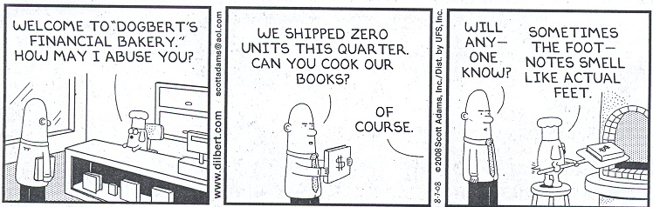
Cooking the books
Play ZZZZ Best

Slide 21
Cooking the Books (Cont’d)
They did a bunch of things to manufacture their fraud. Among these things were:
Creating false accounts receivable and sales
Creating false documents (using photocopies of real documents)
Kiting checks (depositing a check in one bank account from second bank account and then depositing a check into the second bank account from a third bank account to cover that first check. Then they deposit a check in the third bank from the first bank in order to cover the second check, etc.)
Compromising the independence of the internal auditors.
Create documents that made it appear receivables were being collected.
Notes:
ZZZZ best didirikan saat dia berumur 16 tahun
Pinjam dari gangster
Membuat laporan keuangan palsu
22.000 dokumen palsu
Membawa auditor pada hari sabtu untuk mengunjungi gedung yang bukan proyeknya.

Slide 22





Faktor risiko (Risk factors)
RISK
Karakteristik dan pengaruh manajemen
Tingkat Kecurigaan
Kondisi Industri
Karakteristik operasi dan stabilitas keuangan
Pengendalian

Slide 23





Tanggapan auditor terhadap penaksiran risiko berikut dokumentasinya
RISK
Modifikasi sifat, saat dan luas prosedur audit
Presume Risk:
Revenue recognition
Management override
Professional Scepticism
Penugasan Personnel
Prinsip & Kebijakan Akuntansi
Pengendalian

Slide 24
Risk of fraud in revenue recognition
Material misstatements due to fraudulent financial reporting often result from an overstatement of revenues (for example, through premature revenue recognition or recording fictitious revenues) or an understatement of revenues (for example, through improperly shifting revenues to a later period).
Therefore, the auditor ordinarily presumes that there are risks of fraud in revenue recognition and considers which types of revenue, revenue transactions or assertions may give rise to such risks. (ISA 240 p 60)

Slide 25
Risk of fraud in revenue recognition (Cont’d)
In response to a specific identified risk of material misstatement due to fraud related to revenue recognition, based on auditor understanding of the entity and its environment, including the composition of revenues, specific attributes of the revenue transactions, and unique industry considerations, auditor should consider performing the following substantive procedures:
  Substantive analytical procedures relating to revenue using disaggregated data
  Confirming with customers certain relevant contract terms and the absence of side agreements

Slide 26
Risk of fraud in revenue recognition (Cont’d)
  Inquiring of the entity's sales and marketing personnel or in-house legal counsel regarding sales or shipments near the end of the period and their knowledge of any unusual terms or conditions associated with these transactions
  Being physically present at one or more locations at period end to observe goods being shipped or being readied for shipment (or returns waiting processing) and performing other appropriate sales and inventory cutoff audit procedures
  For those situations for which revenue transactions are electronically initiated, processed, and recorded, testing of the operating effectiveness of controls to determine whether they provide assurance that recorded revenue transactions occurred and are properly recorded.

Slide 27
Risk of fraud due to management override of the control
Management is in a unique position to perpetrate fraud because of management’s ability to directly or indirectly manipulate accounting records and prepare fraudulent financial statements by overriding controls that otherwise appear to be operating effectively. While the level of risk of management override of controls will vary from entity to entity, the risk is nevertheless present in all entities and is a significant risk of material misstatement due to fraud.

Slide 28
Risk of fraud due to management override of the control (Cont’d)
To respond to the risk of management override of controls, the auditor should design and perform audit procedures to:
  Test the appropriateness of journal entries recorded in the general ledger and other adjustments made in the preparation of financial statements;
  Review accounting estimates for biases that could result in material misstatement due to fraud; and
  Obtain an understanding of the business rationale of significant transactions that the auditor becomes aware of that are outside of the normal course of business for the entity, or that otherwise appear to be unusual given the auditor’s understanding of the entity and its environment.

Slide 29
Management Representation
The auditor should obtain written representations from management that:
  It acknowledges its responsibility for the design and implementation of internal control to prevent and detect fraud;
  It has disclosed to the auditor the results of its assessment of the risk that the financial statements may be materially misstated as a result of fraud;

Slide 30
Management Representation (Cont’d)
  It has disclosed to the auditor its knowledge of fraud or suspected fraud affecting the entity involving:
      Management;
      Employees who have significant roles in internal control; or
      Others where the fraud could have a material effect on the financial statements; and
  It has disclosed to the auditor its knowledge of any allegations of fraud, or suspected fraud, affecting the entity’s financial statements communicated by employees, former employees, analysts, regulators or others.

Slide 31
2.3 AUDIT PLAN BY ACCOUNT
Notes:
Jika tidak terdapat resiko salah saji yang material maka substantive analytical procedur dapat dianggap cukup untuk menurunkan resiko dari salah saji ke level rendah yang dapat diterima

Slide 32
Design of Substantive Audit Programs - Guidelines
Proportionately more audit resources should be allocated to areas of high audit risk.
Material account balances and transactions generally should receive more substantive audit attention then less material areas.
If the auditors suspects earning inflations, individual item materiality thresholds should be decreased and the auditors should place less emphasis on internal evidence and more on external evidence.
For transactions cycle subsets where internal control is weak and numerous errors are expected, aggregate materiality threshold should be set low, relative to those applicable to strong internal control subsets.

Slide 33
Design of Substantive Audit Programs - Guidelines
In designing substantive audit programs based on risk assessment and materiality considerations, the auditor generally needs to modify the nature, timing, and/or extent of audit procedures contained in the preliminary audit programs.
In determining the necessary modifications, the auditor adopt a qualitatives or a quantitative.

Slide 34
Design of Substantive Audit Programs - Guidelines
Qualitative approach is used for modifying the nature and timing of audit procedures
Quantitative approach is used in altering the extent of audit procedures.

Slide 35
Points Considered in Assessing Risk at The Account Balance and Potential – Error Level
1. Contains entries that are non-systematically processed.
2. Contains unusual or complex transactions. Such transactions may include:
– Complex transactions for which we believe there is a high risk of error
– Transactions that are subject to an unusual degree of management involvement or that produce direct or indirect benefit to management
– Transactions that are unusual for the client's business
– Transactions with related parties that are unusual in size or nature
– Transactions that exhibit characteristics that raise concerns about the possibility of illegal payments
3. Has a history of error, whether or not such errors have been booked by the client in the past.
4. Contains estimates and period-end adjustments.
5. Contains numerous journal entries that may indicate problems with the application systems.

Slide 36
Points Considered in Assessing Risk at The Account Balance and Potential – Error Level
6. Has not been reconciled and reviewed properly or on a timely basis or contains numerous long-outstanding reconciling items.
7. Represents a particular industry risk for this client.
8. Represents a particular risk owing to its value and liquidity.
9. Could be affected by unusual pressures within or on an entity to report certain results.
10. Could be affected because there are questions with respect to the integrity of management.
11. Could be affected by circumstances that result in the need to test the account balance for both overstatement and understatement:
– Tests that support other procedures
– Tests that address a specific identified risk.

Slide 37
2.4 MODEL AUDIT PROGRAM
Notes:
Jika tidak terdapat resiko salah saji yang material maka substantive analytical procedur dapat dianggap cukup untuk menurunkan resiko dari salah saji ke level rendah yang dapat diterima

Slide 38
See case PT Ban Indonesia

